Slide 1
Do Apps Need Local Storage?
Liam Westley @westleyl
Application Architect, Huddle liam.westley@huddle.com

Slide 2
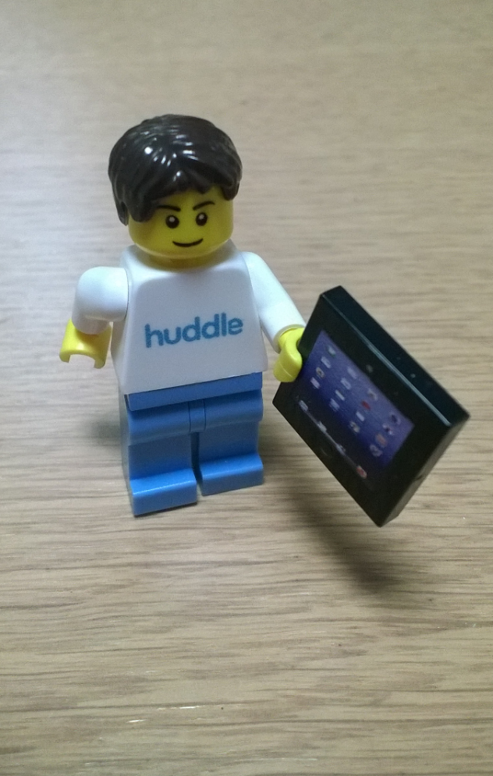
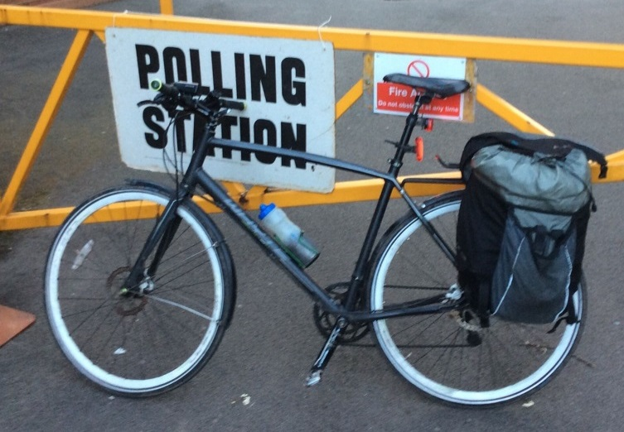

Who is Liam Westley?
< commute
play >
< work
Notes:
Lego minifig Huddle architect courtesy of Betsy Weber, of TechSmith.
Polling Station – London Assembly and Mayoral elections, May 2016.
Egg and Spoon Race – Blists Hill Victorian Town, Ironbridge Gorge Museums, Ironbridge, UK.
http://www.ironbridge.org.uk/

Slide 3
A mobile app that has no local
storage is just a glorified web
application that doesn’t work
properly when your device is
offline.

Slide 4
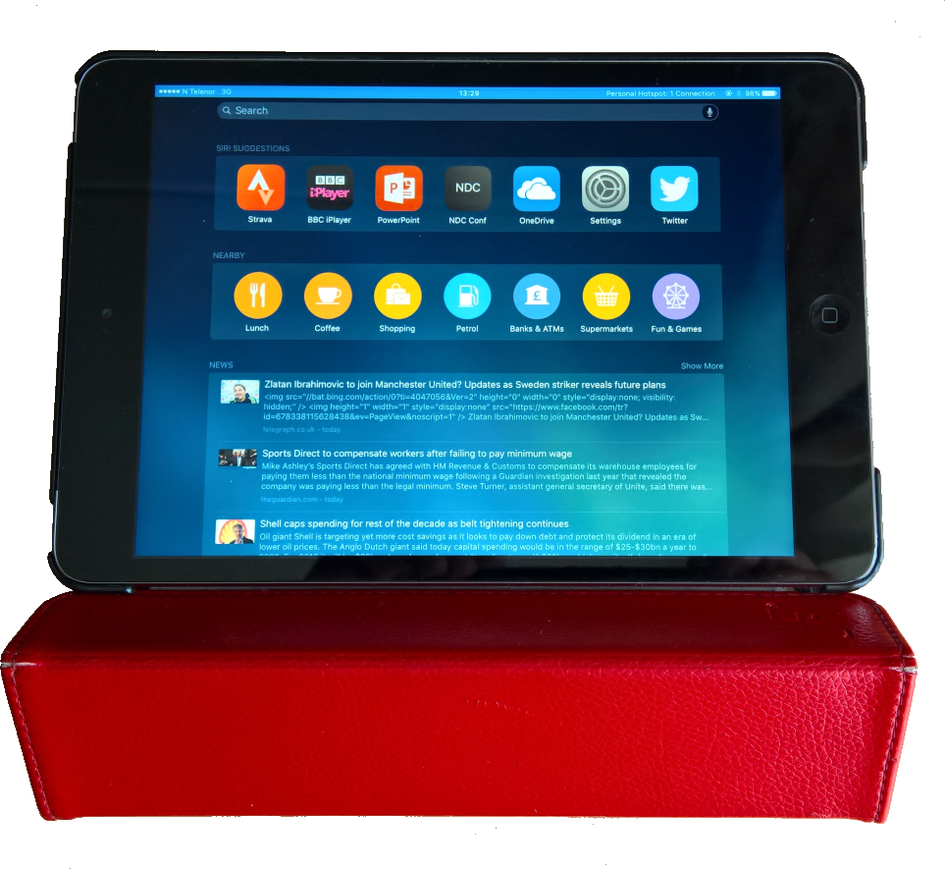
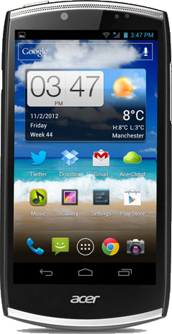
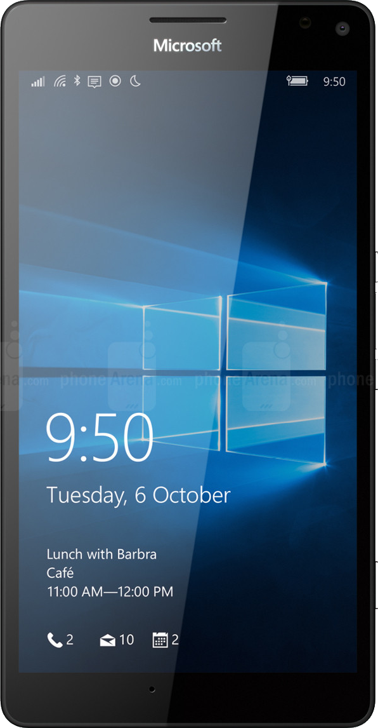
How come you’re the expert?
Notes:
Today my primary device is a Lumia 950 xl, running Windows Phone 10 with a voice and text SIM (including unlimited 4G data); used for music and podcast playback, tracking my cycle commute into work with Adidas miCoach, e-mails and messaging, and reading my digital copy of The Economist.
My secondary device is an iPad Mini 2, running iOS 9, with a 4G data SIM; this tracks my commute using Strava (not available for Windows Phone) as well as running BBC iPlayer.
I also have a WiFi only Nexus 9 running Android 6.0.1 (Marshmallow), as well as an old Acer S500 mobile running Jellybean. These are normally left in the office.
A long winded introduction, but I hope it provides some context, including my experience of using the ‘same’ app on different devices where the publisher does not necessarily provide the same functionality in terms of local storage.

Slide 5
Categories of Apps

Slide 6

Hybrid apps – online and offline
Striking the balance between the caching of data offline with updating or augmenting the local data when online
Notes:
The messaging and social networks are fine examples of hybrid apps. They cache content offline, such as news feeds and message history which are really handy if you have lost your data connection. However, they quickly become stale if you remain offline and cannot download new content.
Messaging applications often rely on immediacy. If you are updating your location on Foursquare or want to upload a new photo to Instagram, you really are going to want to be online.

Slide 7
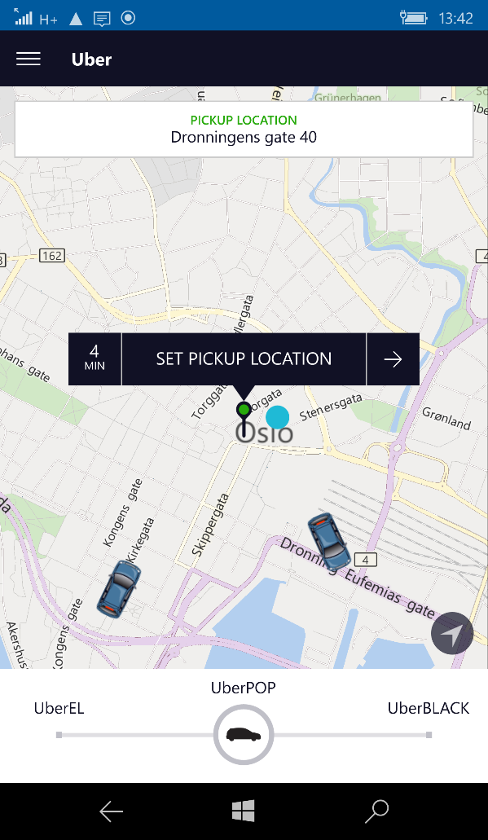
All online (pretty much)
More common with sensitive data, or when the app is dealing with real time data such as weather or stock prices.
Notes:
If you are going to use Uber to catch a taxi, the app has to be online. The entire purpose of Uber, finding a nearby taxi, requires being online to communicate between the rider and the driver.
The Uber app for riders has no local storage. If you want to view journey histories, you must be online. Editing your profile and adding payment options, all requires a data connection.

Slide 8
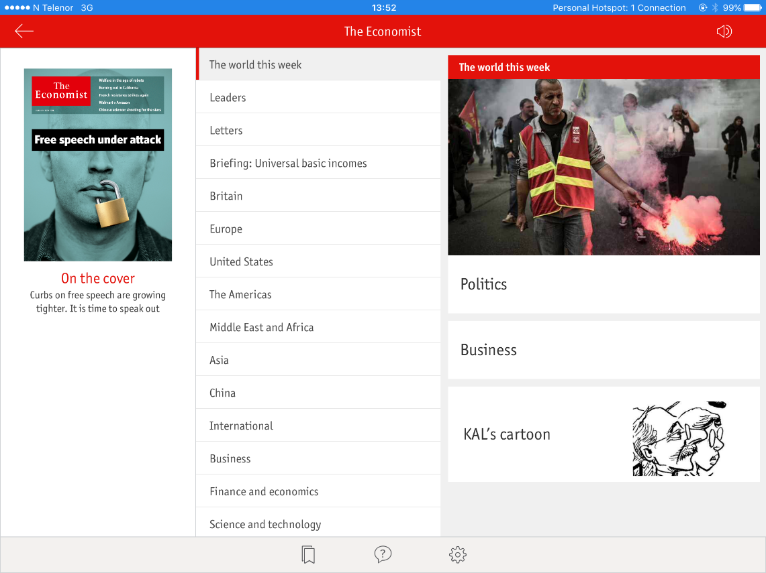
All data local to the device
These apps are becoming quite rare, with cloud storage being ubiquitous and users wanting some method of online access to data
Notes:
Very few apps survive solely on locally cached data. Amazon Kindle or magazine apps like The Economist are designed to download content for the purpose of offline browsing. This is incredibly useful when you might be on holiday where you might not have access to a mobile data connection, or rather, an affordable mobile data connection.
One of the apps that leverages local data is HERE maps for Windows Phone (and now iOS and Android). Not only can an entire country be downloaded for later use, but navigation is available while offline. This is a legacy from the Nokia acquisition of Navteq which provided in car satellite navigation technology when no online capability was available.
In comparison Google Maps started as an online offering which only recently supported offline use.

Slide 9
When does storage matter most?
Notes:
As an example of real world local storage issues, consider a recent trip I made to Seattle, in the US. Both my SIMs are on the Three network, who include the US as a ‘Feel at Home’ country which meant my UK phone contracts came with me to the US. That meant pretty much free data allowance on both the phone and the iPad, but even then, local storage mattered.

Slide 10
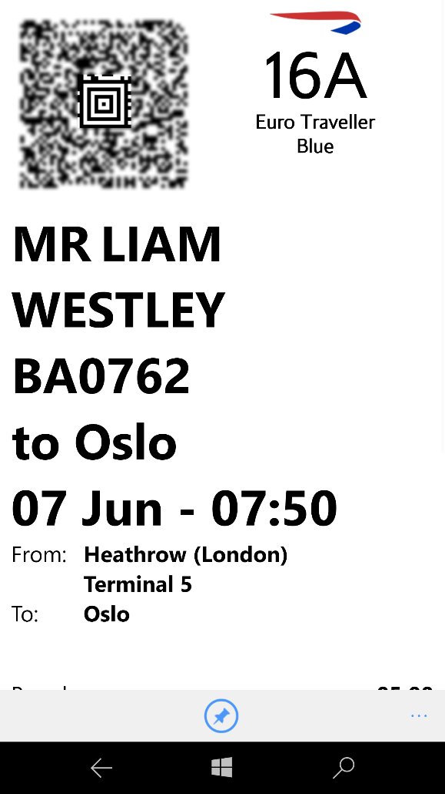
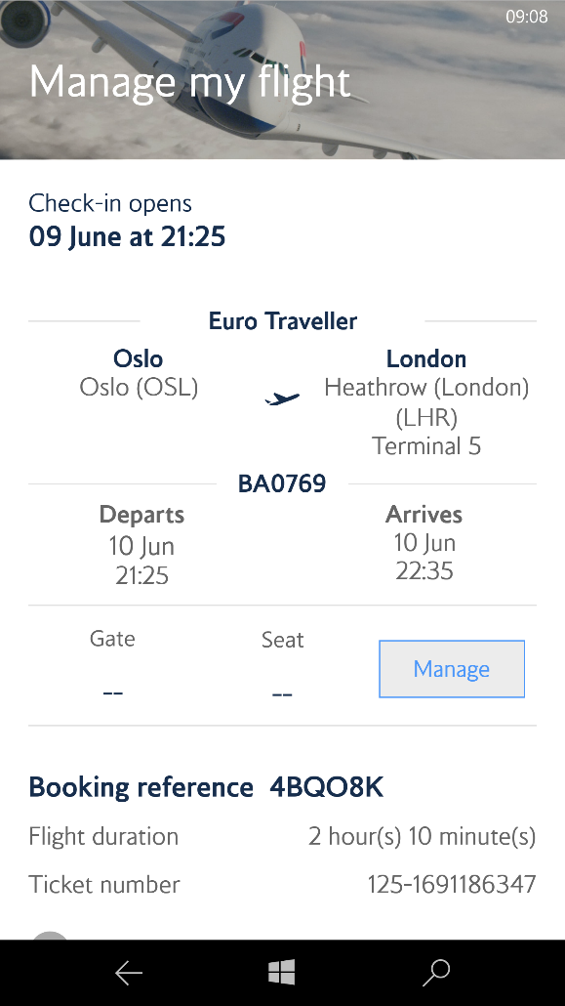
British Airways app
British Airways – local storage optional, but extremely useful when you want to have a boarding card!
Live updates on flight status and gate

Slide 11
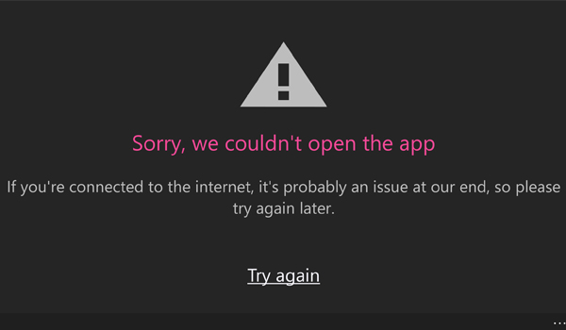
BBC iPlayer
Local storage is pretty essential, especially on a plane
Painful with Windows Mobile – streaming only, no downloads
Notes:
Let me expand on that statement, you can download content on iOS and Android, but not on Windows Mobile. This is one reason I barely use BBC iPlayer on Windows Mobile – I may have an unlimited data plan but at 30,000ft or on an underground tube train that’s pretty useless. It’s not that useful on trains above ground or buses as even in London the mobile signal can be patchy.
Before I left the UK, I download copies of the past few weeks of recordings that I’d made on my PVR to the iPad Mini so I could watch them while I was in the US. This made for a very personal in-flight entertainment system on the return journey on an ancient 747 with a tiny 4:3, 5” screen.

Slide 12
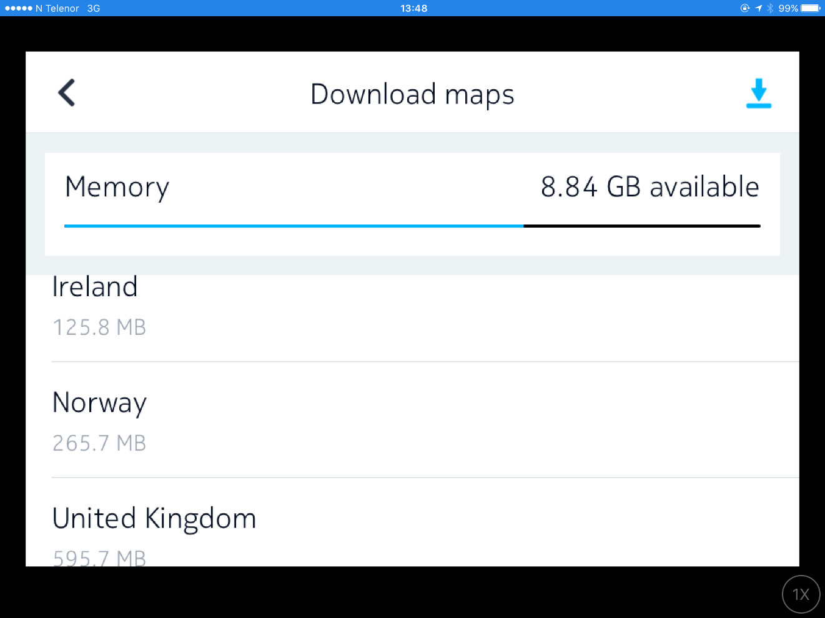
Maps
Local storage optional, as long as you have ‘free’ data
Online data can be important though for live traffic information
Notes:
Before leaving the UK, I also downloaded the entire Washington state map in HERE Maps on my Windows Phone. This made it trivial to plan routes, and even have turn by turn instructions for walking around Seattle. This was a trick I’d learnt the previous year at NDC Oslo, as unlike in the US I had no data connection in Norway for online navigation.
Having locally cached maps and navigation has now become an important feature. Google Maps added support for downloading of map areas and offline navigation in November 2015, replacing the hit and miss local maps it previously used. (https://googleblog.blogspot.co.uk/2015/11/navigate-and-search-real-world-online.html)
This isn’t a slam dunk for local storage though. The addition of live traffic information can really help with calculating an optimal route. Google Maps excels in this area as it tracks many more users and therefore can tap into a larger source of data for traffic disruptions.

Slide 13
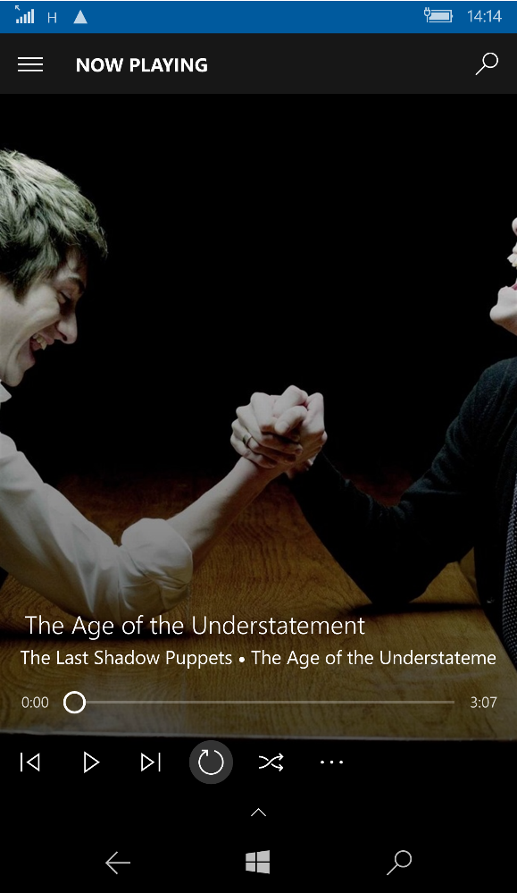
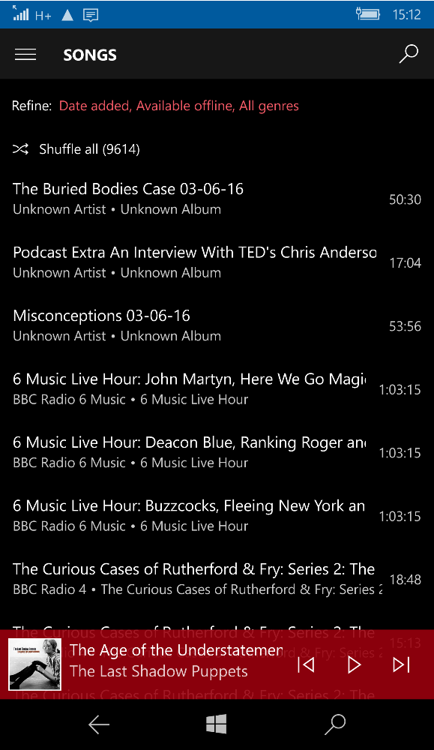
Music players and streaming
Local storage when becomes really useful, Spotify and Apple Music can cache local content but you have to be check it’s actually really local
Notes:
If you haven’t got a data connection, your streaming services are pretty much useless. Having some music tracks locally is a must at this point. As well as playing local music files, Spotify provides the ability download streamed files locally for future use.
This is handy for both Spotify (it saves on streaming costs) as well as for the user who can listen to music without a data connection. As a user you should take care though. When I used Spotify on Android, every time Spotify received an app update it happily deleted all cached local content and I had to laboriously play all that content again to enable offline playback.

Slide 14
Challenges of local storage
Notes:
The challenge of local storage generally boils down to updating the local cache, and when items might expire. For Google Maps, you must update the maps at least every 30 days. Applications that rely on subscriptions require online access regularly to confirm a user still has permission to access the content.

Slide 15
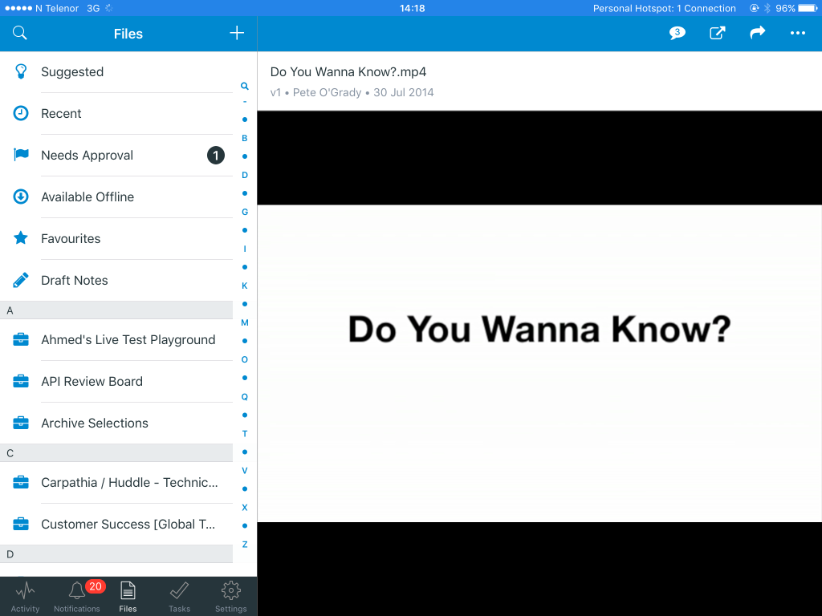
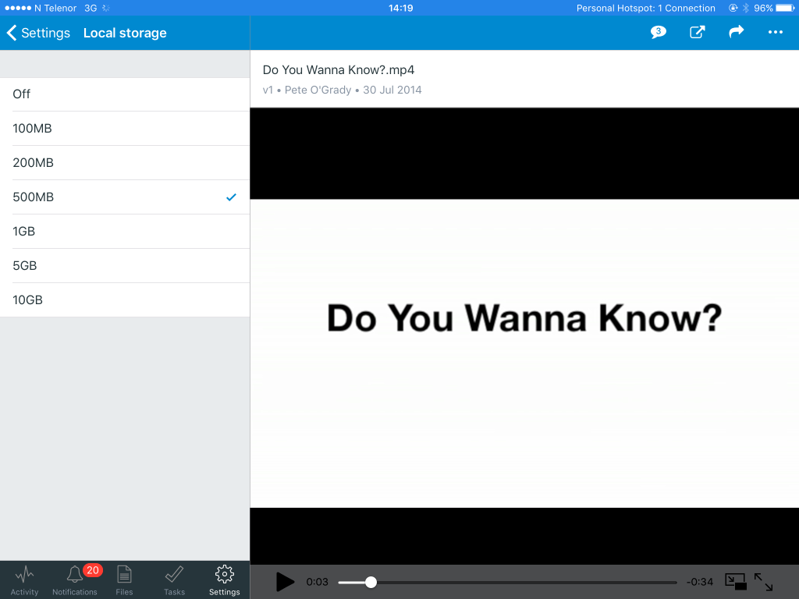
Synchronisation
When and what to synchronise?
Local changes can be propagated back to the source when the device is next online
Notes:
The Huddle iOS app has the ability to read offline documents, comment on documents and add new documents. When the device is next online, those actions can be replayed to the Huddle server so the comments and new documents are available to other users. Some time-sensitive actions are not available, such as requesting an approval for a document from colleagues as these require notification of other colleagues that an approval is required.

Slide 16


Security
Another consideration of local storage is protection of data, especially when that data is confidential.
Notes:
Confidential information including PII (Personally Identifiable Information) has to treated very carefully, as new EU laws (likely to apply to associate members like Norway) are becoming much stricter about privacy.
If a user has the ability to logout of an application, or an application is uninstalled, it is likely that there is a requirement for all local cached data to be removed.
For Spotify, the act of updating the app might well cause the DRM (Digital Rights Management) to be updated. This is the type of update that would require all local content to be removed during the update as it will no longer be playable by the new DRM logic.
Images from
Lock - https://pixabay.com/en/castle-security-closed-to-locked-214452/
Rubbish bin - https://pixabay.com/en/garbage-basket-bin-trash-rubbish-40357/

Slide 17
Taking local storage to the next level

Slide 18
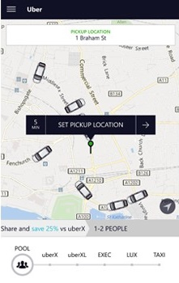
Uber
The driver app and rider apps are quite distinct – both require online in order to create a journey but the driver app is very capable offline
Notes:
With Uber the driver app is quite distinct from the rider app. The driver app has significant offline capability, tracking and storing the journey details, handling confirmation of billing, and is even relied on for scaling and high availability (see http://highscalability.com/blog/2015/9/21/uber-goes-unconventional-using-driver-phones-as-a-backup-dat.html).
While the matching of a rider and driver require both apps to be online, once a journey is started the remainder of the transaction can be handled offline as long as the driver app eventually uploads the journey to an Uber data centre.

Slide 19
Conclusions

Slide 20
What do users want?
Users don’t want to know whether they are offline or online
Apps should work offline if it makes sense
They don’t want to login and download content every time they run an app
Apps are not goldfish, they should remember things for more than 30 seconds
Users hate having to remember web addresses, or navigate
Notes:
Users really don’t care if they are offline or online, they expect their apps to hide the complexity from them as the roam from WiFi to mobile data and back again.
They expect their apps to work offline – when they don’t have a data connection is precisely when they have a spare moment to catch up on social network feeds.
They don’t want to have to login every time they use an app, they don’t want to keep downloading content every time they user an app – it’s a waste of their time and their data allowance.
They don’t want to remember a web address, or have to go to favourites in their browser.

Slide 21
What should developers do?
Can you use your app, in any meaningful way, when it is offline?
What historical data will your users want to browse when offline?
What data is generated by the app itself, and how will you store that before uploading to a central location when the device is next online?
What functions should be made available for offline use, and what are the implications of synchronising any actions when the device is next online?
Notes:
If you are a mobile app developer there is always a tricky balance between the offline and online capability of your application. There is not one rule for all apps, it depends on the use case in question and the expectations of your users.
Always remember that one-way synchronisation (from data centre to device) will always be easier than a two-way synchronisation, and will limit the possibility of conflicts.

Slide 22
… and finally

Slide 23
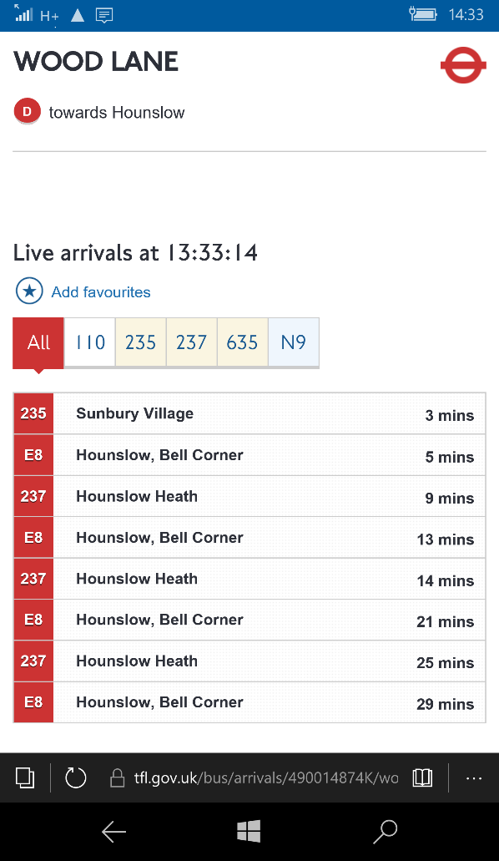
Is there still a place for a web app?
YES !
Notes:
If you are stood at a bus stop in London, the best thing you can do is grab your phone, browse to http://m.countdown.tfl.gov.uk – where you can find the nearest bus stop to find out when the next bus will be arriving. There really is no need for this to be a native application.

Slide 24
Based on an original blog post for Microsoft UK developers
http://tinyurl.com/zdq2vsd
https://www.microsoft.com/en-gb/developers/articles/week02mar16/does-a-mobile-app-need-local-storage/

Slide 25
Do Apps Need Local Storage?
Liam Westley @westleyl
Application Architect, Huddle liam.westley@huddle.com

